Slide 1


Getting Started with Mobile App Development

Slide 2

What is Mobile App Development?
Process of creating software applications that run on a mobile device.
Typical mobile application utilizes a network connection to work with remote computing resources.

Slide 3

Pitch an Idea Choose your platform Build your App Publish it
How Mobile Apps are Built?

Slide 4

Native mobile development allows you to build apps for a particular operating system — either Android or iOS. Cross-platform mobile development, in contrast, allows you to build apps that target several operating systems.
Native Vs Cross-Platform

Slide 5
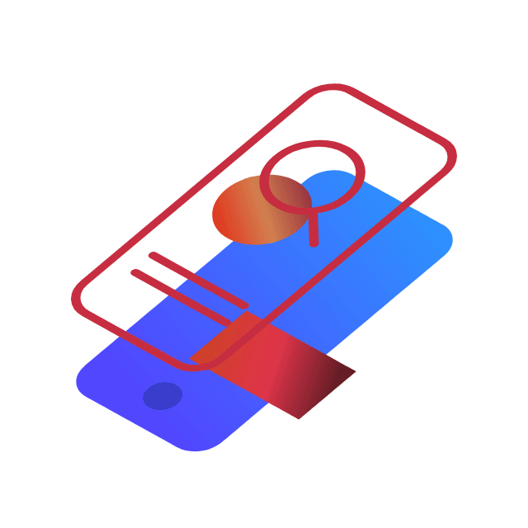
Getting Started with Native Mobile App Development

Slide 6
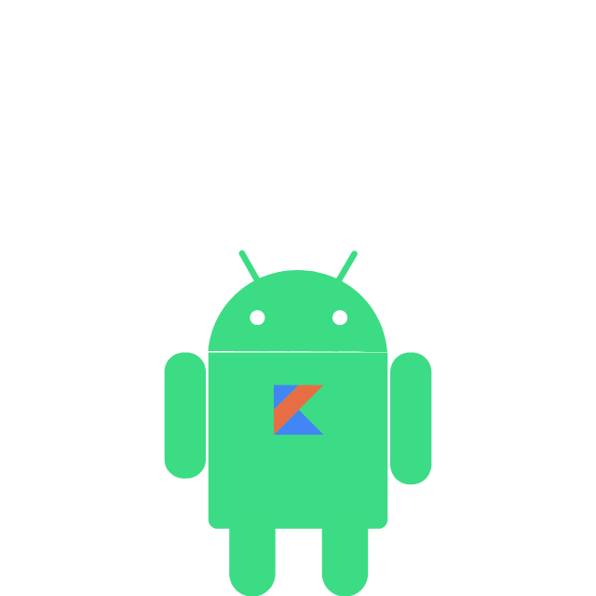
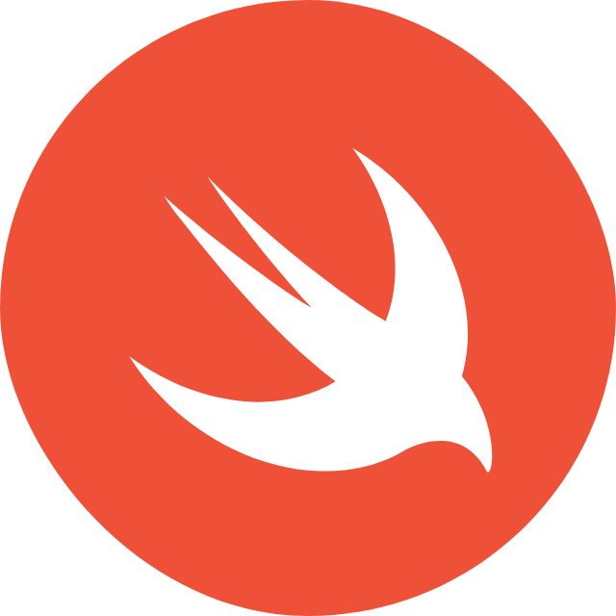
Native App Development

Slide 7

What is Kotlin ?
Kotlin is an open-source, statistically-typed programming language created by JetBrains.

Slide 8

Why to chose Kotlin over Java?
Shorter program for the same task
Easy Code
Java Compatibility
Eliminating Null References

Slide 9
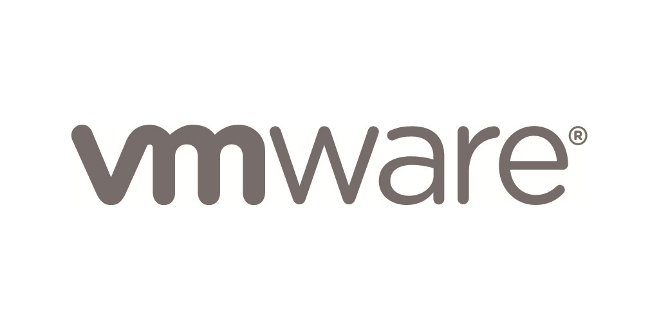




Some famous apps built in Kotlin

Slide 10
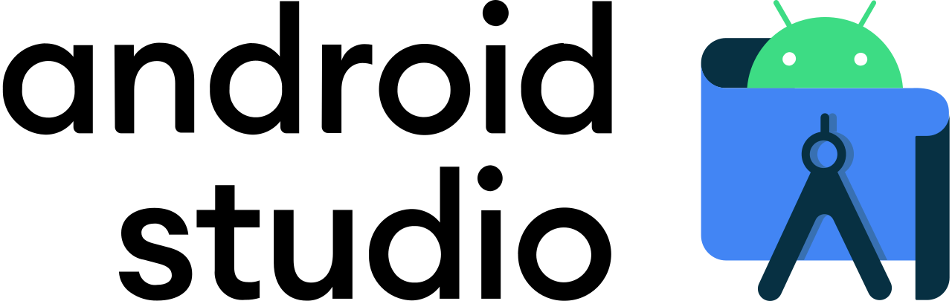
Install Android Studio

Slide 11
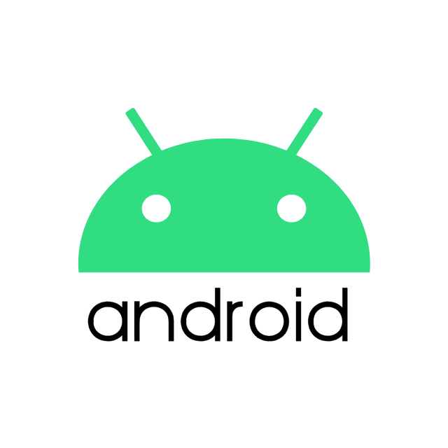
Android Basics Course in Kotlin
Unit 1 : Kotlin Basics
Unit 2 : Layouts
Unit 3 : Navigation
Unit 4 : Connect to the Internet
Unit 5 : Data persistence
Unit 6 : WorkManager
Check them out at Android Basics in Kotlin

Slide 12







Other Resources
YouTube Channels
Udemy Courses
Philipp Lackner
Kotlin for Beginners by Peter Sommerhoff
The Essential Kotlin Programming Course by Jason Fedin
Telusko
Codetutor
Donn Felker
Kotlin for Java Developers by JetBrains
Meta Android Developer Professional Certificate

Slide 13
Backend for your Kotlin App

Slide 14



Resources
YouTube Channels
Learn how to use Kotlin for Back-end Development by Objectivity
Developing Backends with Kotlin by JetBrainsTV
Telusko
Learn Code with Durgesh

Slide 15
Kotlin – Pros and Cons
Pros
Cons
Complies with existing Java code
Less buggy
Accelerates UI development
Increases team efficiency
Fluctuation in Compilation
Android CompileOptions

Slide 16
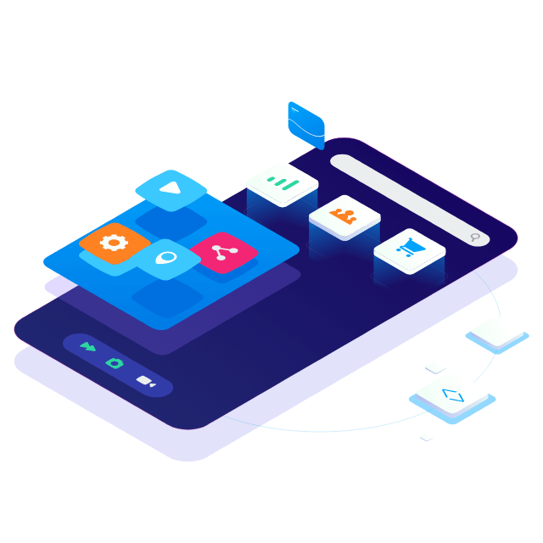
Getting Started with Cross Platform Mobile App Development

Slide 17
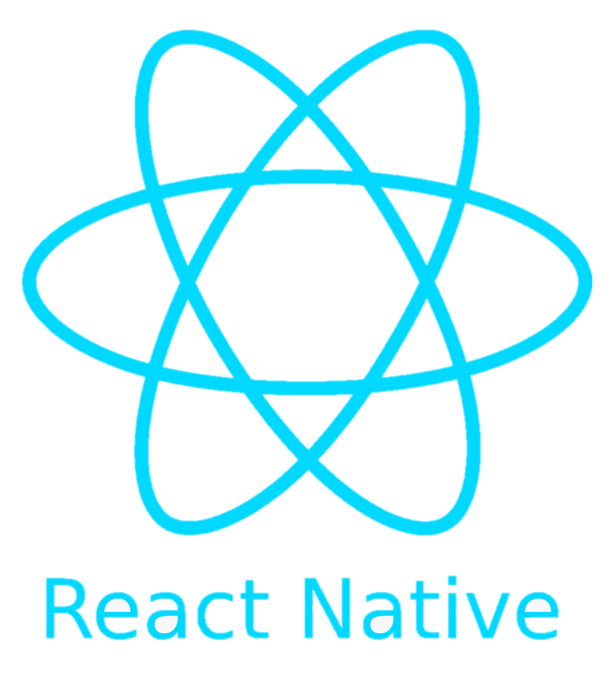
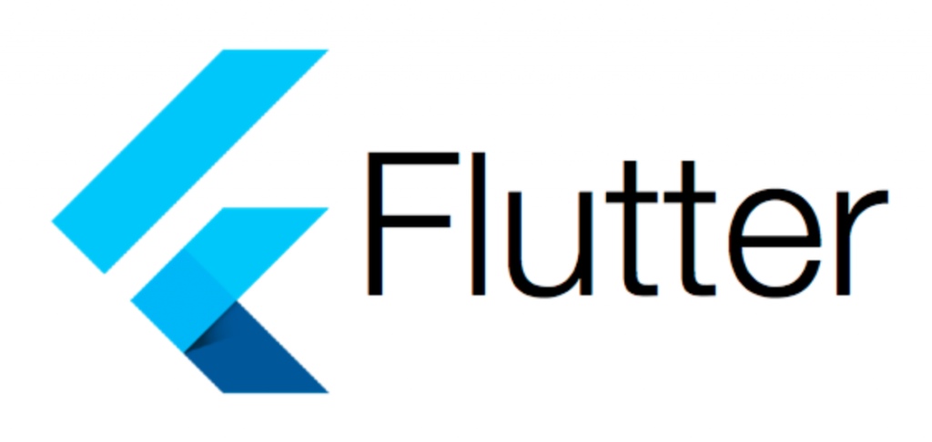
Cross-platform App Development

Slide 18
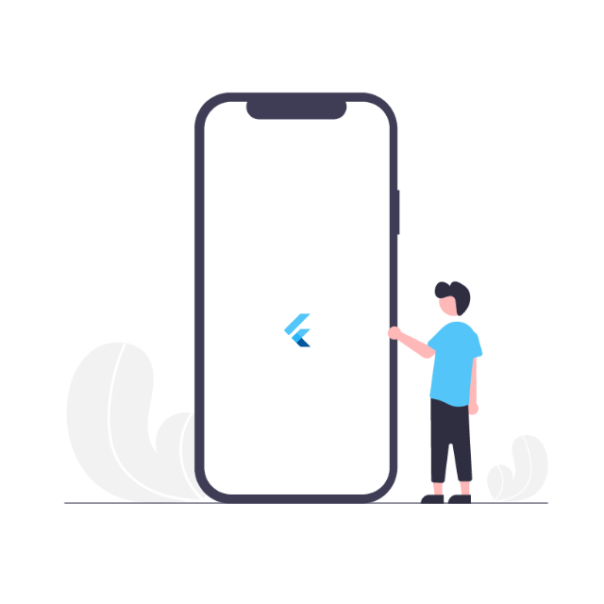
What is Flutter ?
Open-source cross-platform mobile application SDK developed by Google
Used to develop both Android and iOS applications
Written in Dart language

Slide 19

Why Flutter ?
Open Source
Single Codebase
Hot Reload
Native App Like Performance
Requires Less Testing
Use of Custom Widgets
Tech Community

Slide 20


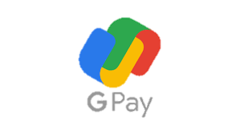

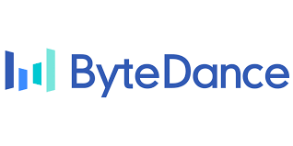

Some famous apps built on Flutter Framework

Slide 21


Learn Dart Programming language
Object Oriented Programming concepts
Variables, classes, methods,
Operators, Control flow statements, Maps, Lists
Dart Programming for Flutter
Practice

Slide 22
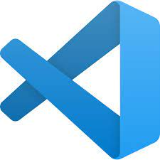
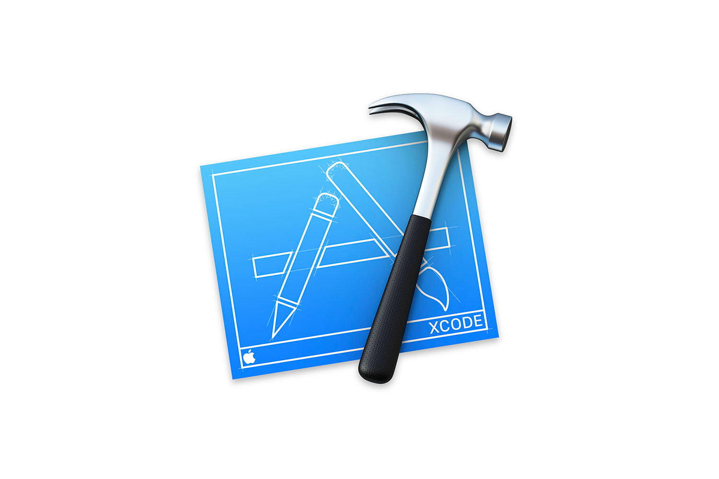
Install Development Platforms

Slide 23
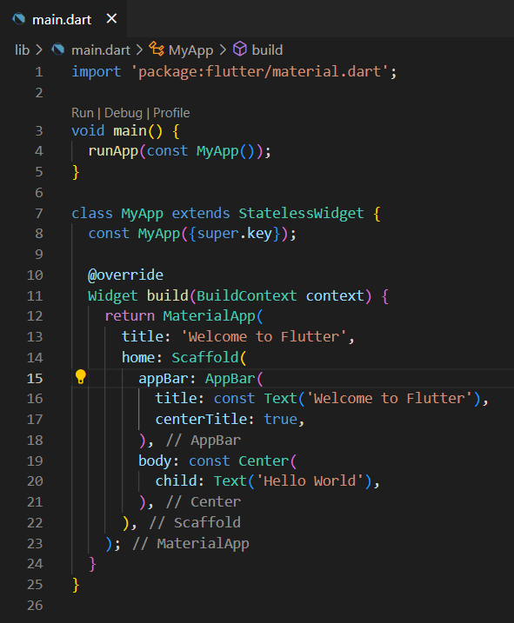
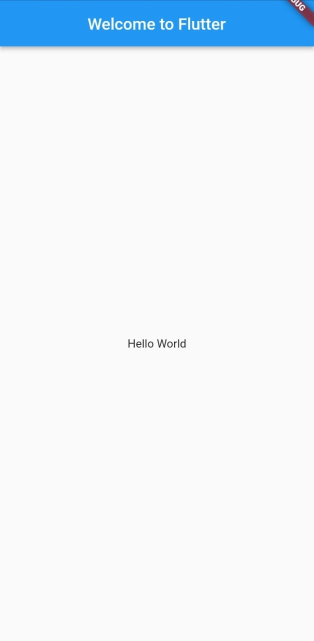
Write your first Flutter App

Slide 24

Google Codelabs
Involves step by step procedures to code challenges.
Follow along the codelabs.
Check them out at Codelabs

Slide 25




Other resources
YouTube Channels
Udemy Courses
Dart and Flutter: The Complete Developer's Guide by Stephen Grider
The Complete Flutter Development Bootcamp with Dart by Dr. Angela Yu
The Net Ninja
Codepur
Flutter Mapp
freeCodeCamp.org
Getting started with Flutter Development

Slide 26

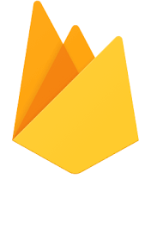
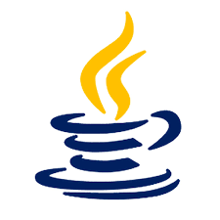

Backend for your Flutter App

Slide 27

What is Firebase?
Backend-as-a-Service (BaaS)
Develop quality apps, grow user base, and earn profit.

Slide 28
Why Firebase?
Storage
Hosting
Authentication
Firebase ML
Realtime Database
Crash Reporting

Slide 29


Resources
YouTube Channels
The Net Ninja
Firebase
Johannes Milke
freeCodeCamp.org

Slide 30
Flutter – Pros and Cons
Pros
Cons
Low Costs
Code reusability
Rapid development
Easier maintenance
Larger digital footprint
Delayed platform features
Difficult integrations
Lower performance

Slide 31

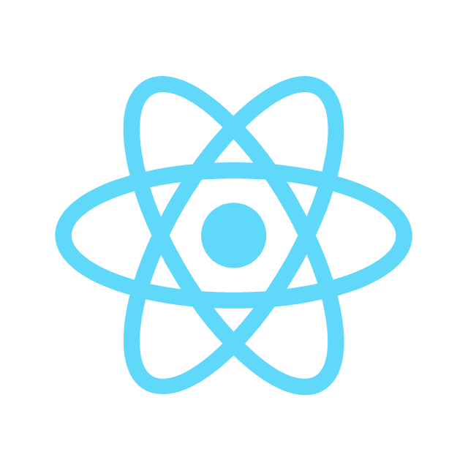
Native vs Cross Platform?

Slide 32


